Slide 1
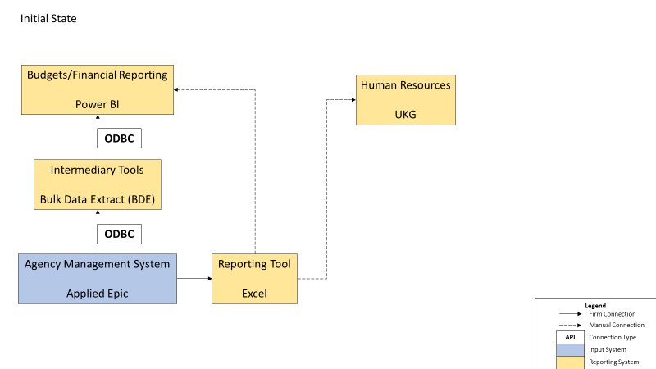

Data Processes Applied/Epic (cont.)
Where we’ve been.
Heffernan Insurance Brokers | License #0564249

Slide 2
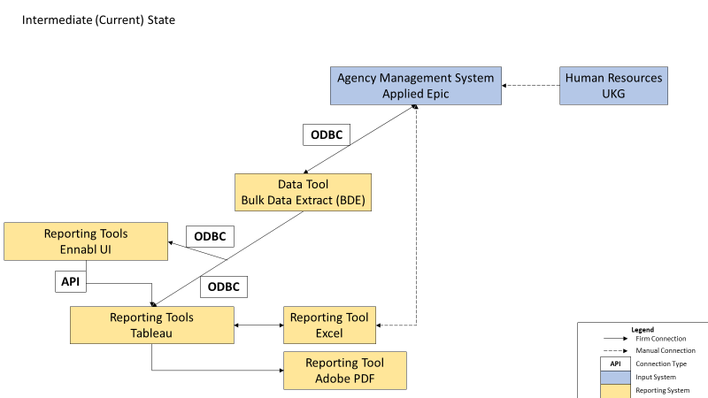
Data Processes Applied/Epic (cont.)
Where we are.
Heffernan Insurance Brokers | License #0564249

Slide 3
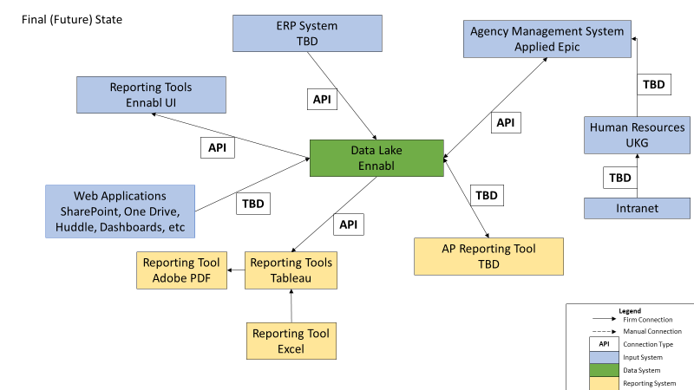
Data Processes Applied/Epic (cont.)
Where we’re going.
Heffernan Insurance Brokers | License #0564249

Slide 4

Future State
Notifications/Reports/Creation of New Metrics/New Programs
New Integration Work
ERP Platform will be started (sometime Q4’23)
Middleware package needed for communication with Epic
BDE hookups to Middleware will need to be setup/tested/QA’d
More work with Ennabl for 2nd half of 2022/early 2023
Exceptions Dashboard for Q4’22/Q1’23
Phase 2 and Phase 3 implementation items TBD
Early Identified Work: Heffernan Network Integration
Additional Metrics in Tableau
To avoid being caught in Ennabl’s development cycle, most can be
designed in Tableau and with Ennabl for future UI inclusion. This is done to
create one unified platform across the firm.
Example: Cross-Sells by Account Manager or Revenue by Ultimate Carrier
Further Requests for KPIs (by Operations post initial rollout in August) also highly likely
Heffernan Insurance Brokers | License #0564249

